Slide 1
Promotional
Effectiveness - ShopRite
Divya Rathore
Shruti Tripathi
Shivakumar Barathi
Prof. Khasha Dehnad
BIA-672-B Marketing Analytics – Fall 2018

Slide 2
Goals
Score promotions based on Sales Revenue, Lift, Gross Profit
Identify promotions and part of promotions that are
Productive
Unproductive

Slide 3
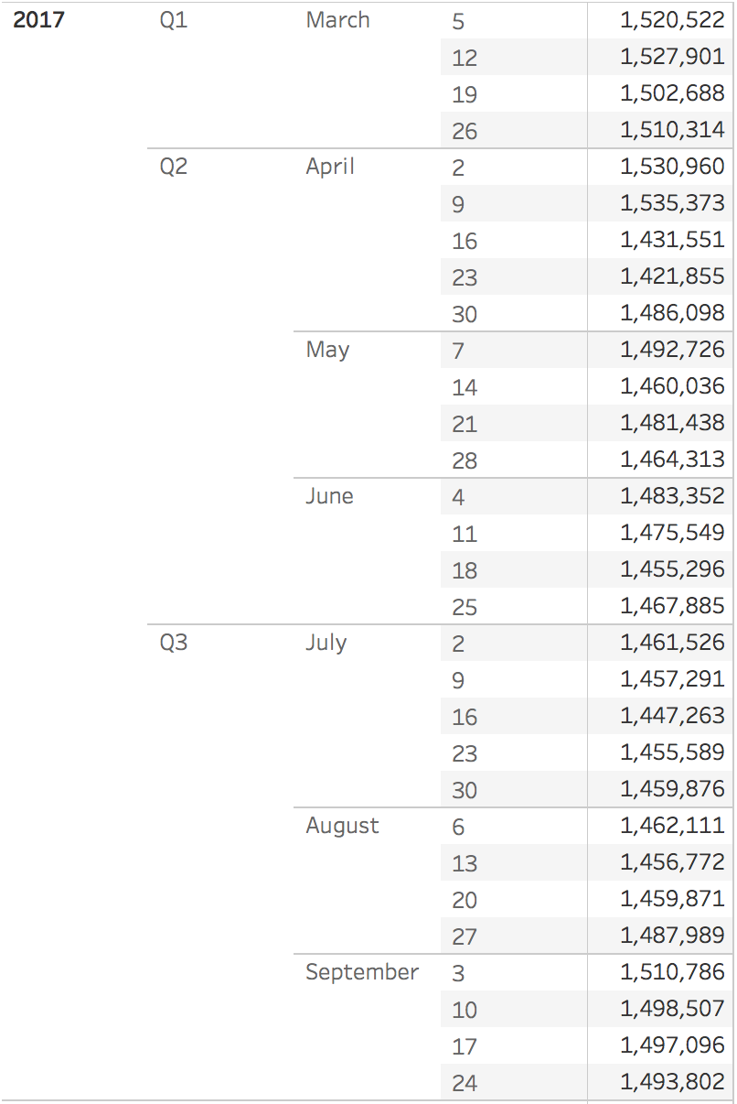
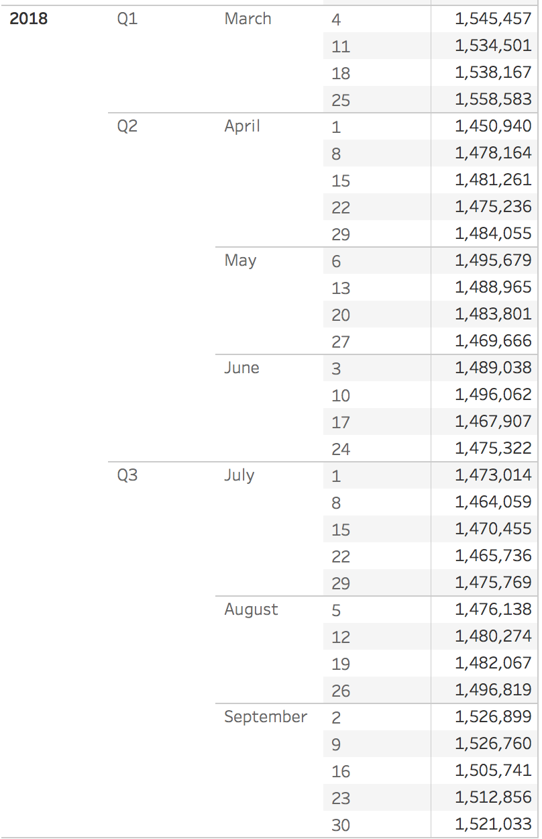
Data Files
Total Dimension – 90686785 rows and 21 columns

Slide 4
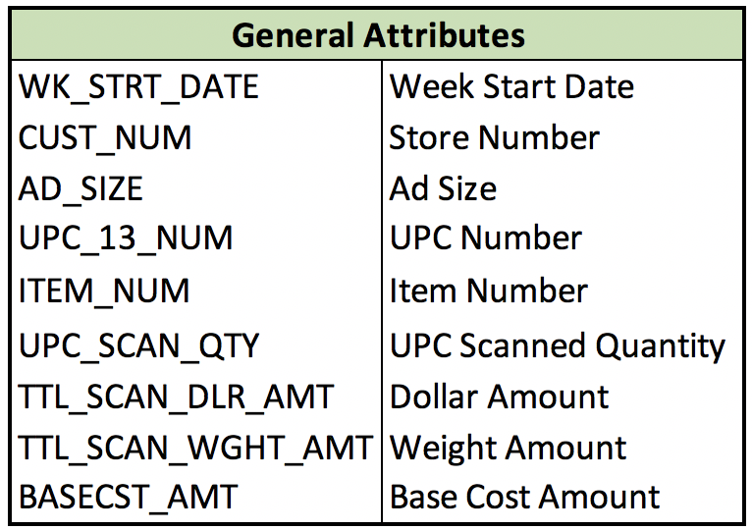
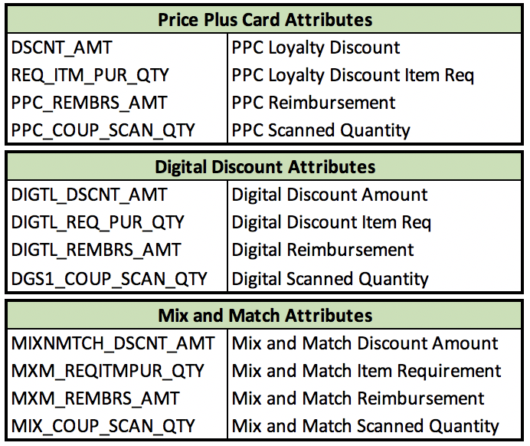
Data Dictionary

Slide 5
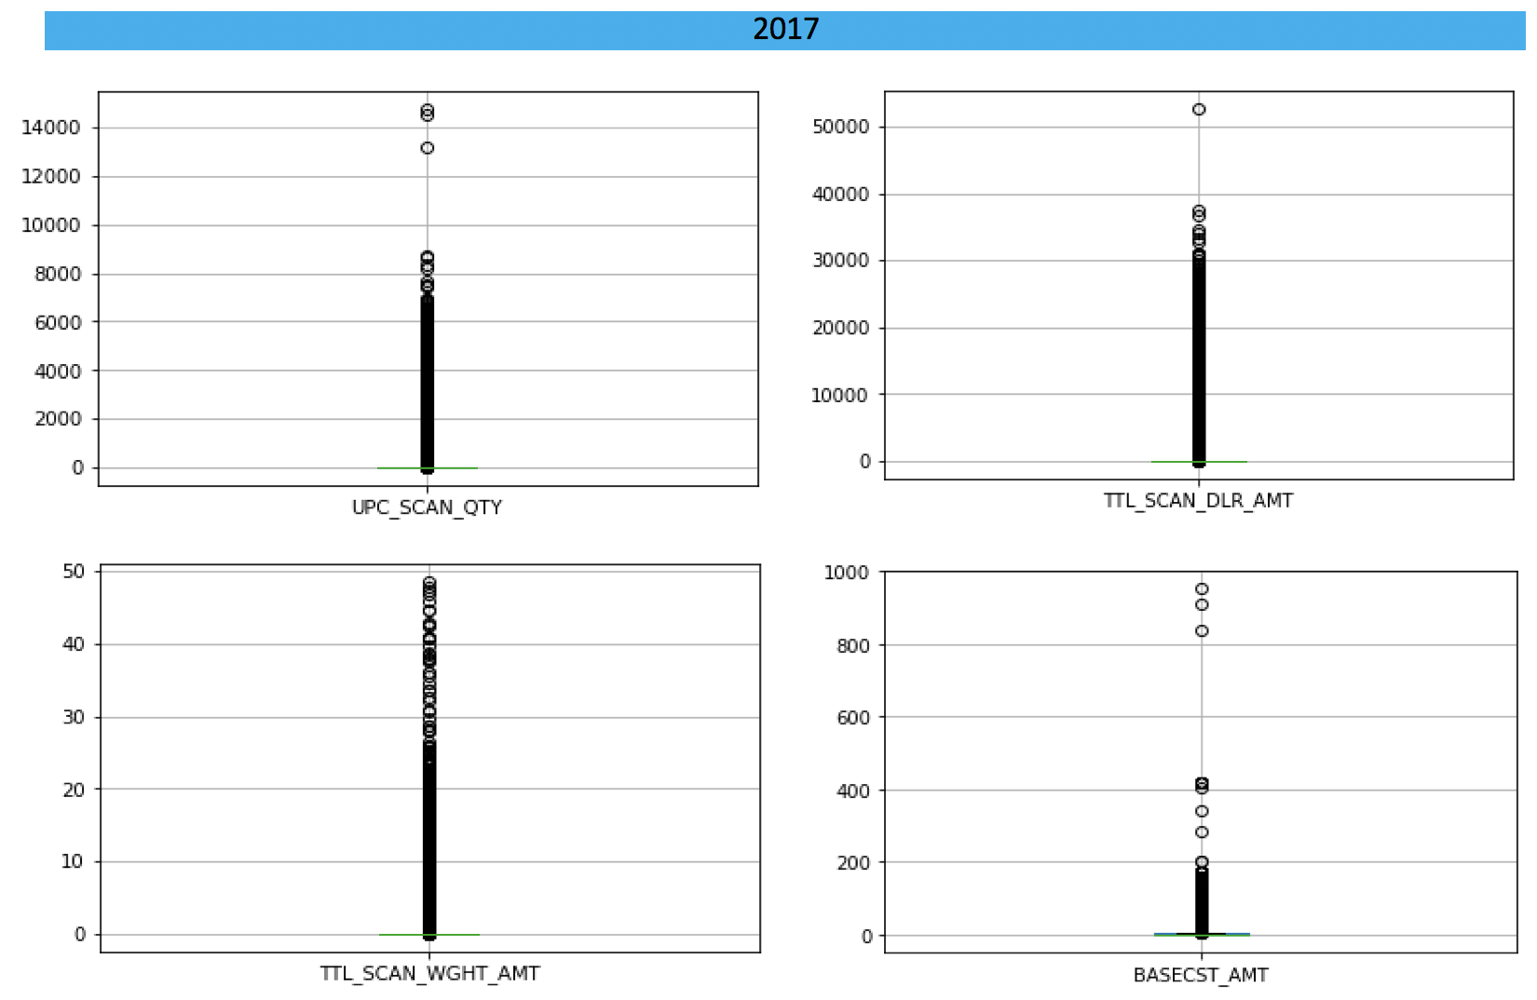
Outlier detection – box plots - 2017

Slide 6
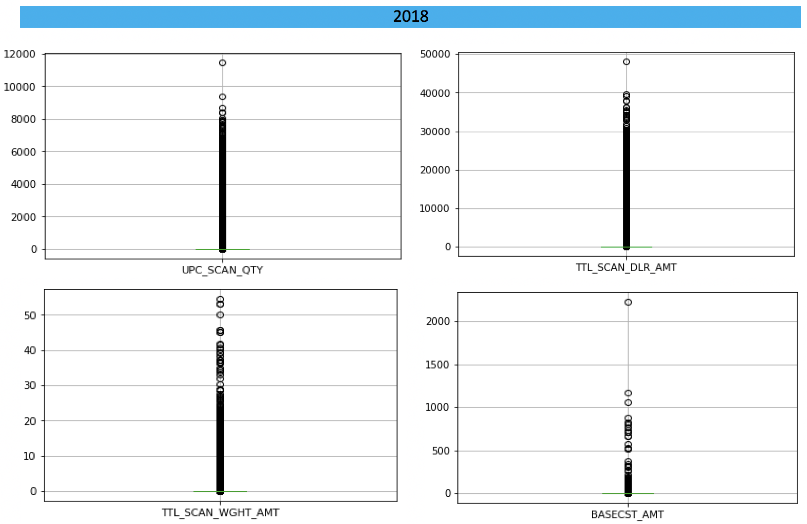
Outlier detection – box plots - 2018

Slide 7
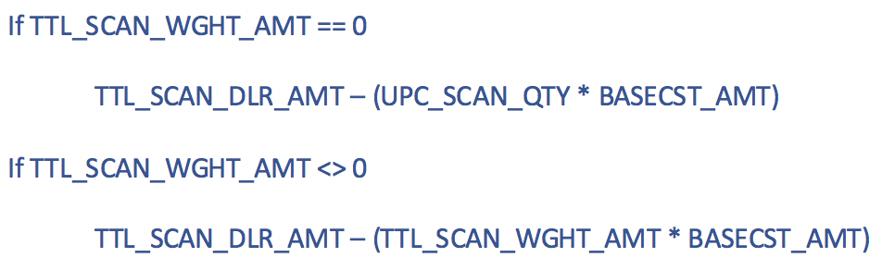
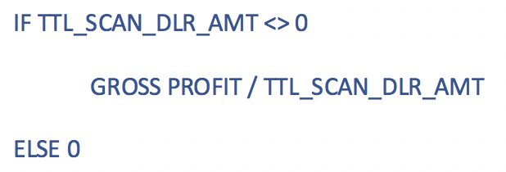
Feature engineering
Merged certain ad sizes
BLANK, 0, and 4 – Not Promoted
3 and 5 – In-store Promotion
Gross Profit
Gross Margin

Slide 8
Promotional lift
Represents an increase in sales in response to some form of advertising or promotions
Promoted Items
In a particular store
For a particular item
Previous Week – Ad Size is [BLANK] or 0 or 4
Current Week – Ad Size is 3 or 5 or 6 or 7 or 8 or 9

Slide 9
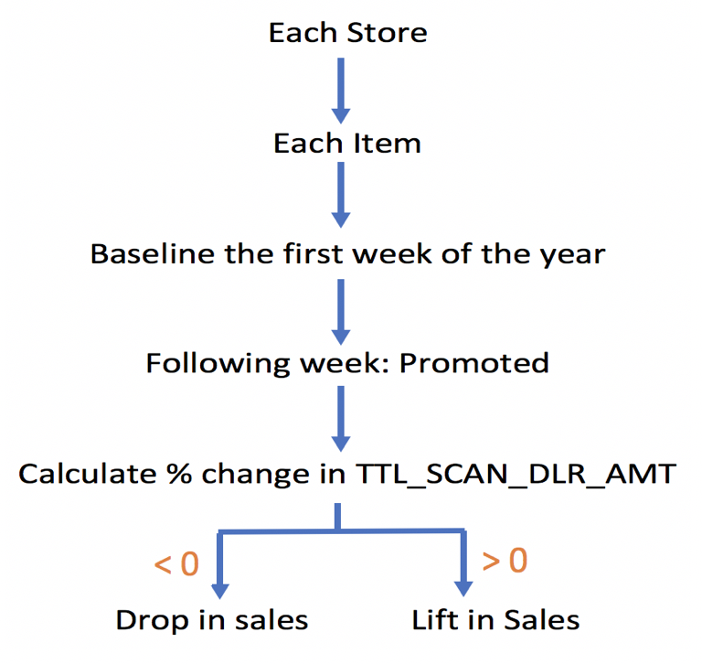
Flow to identify lift in sales

Slide 10
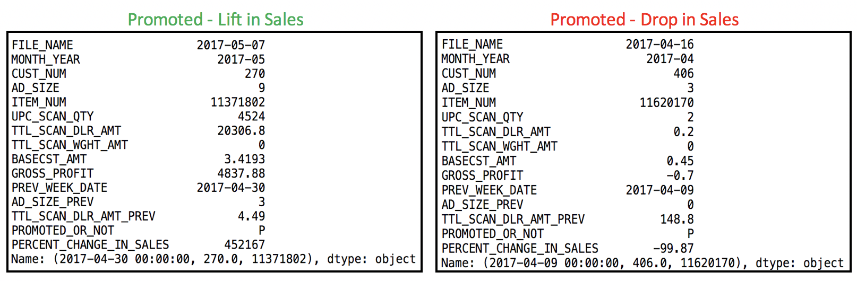
Lift in sales vs Drop in sales

Slide 11
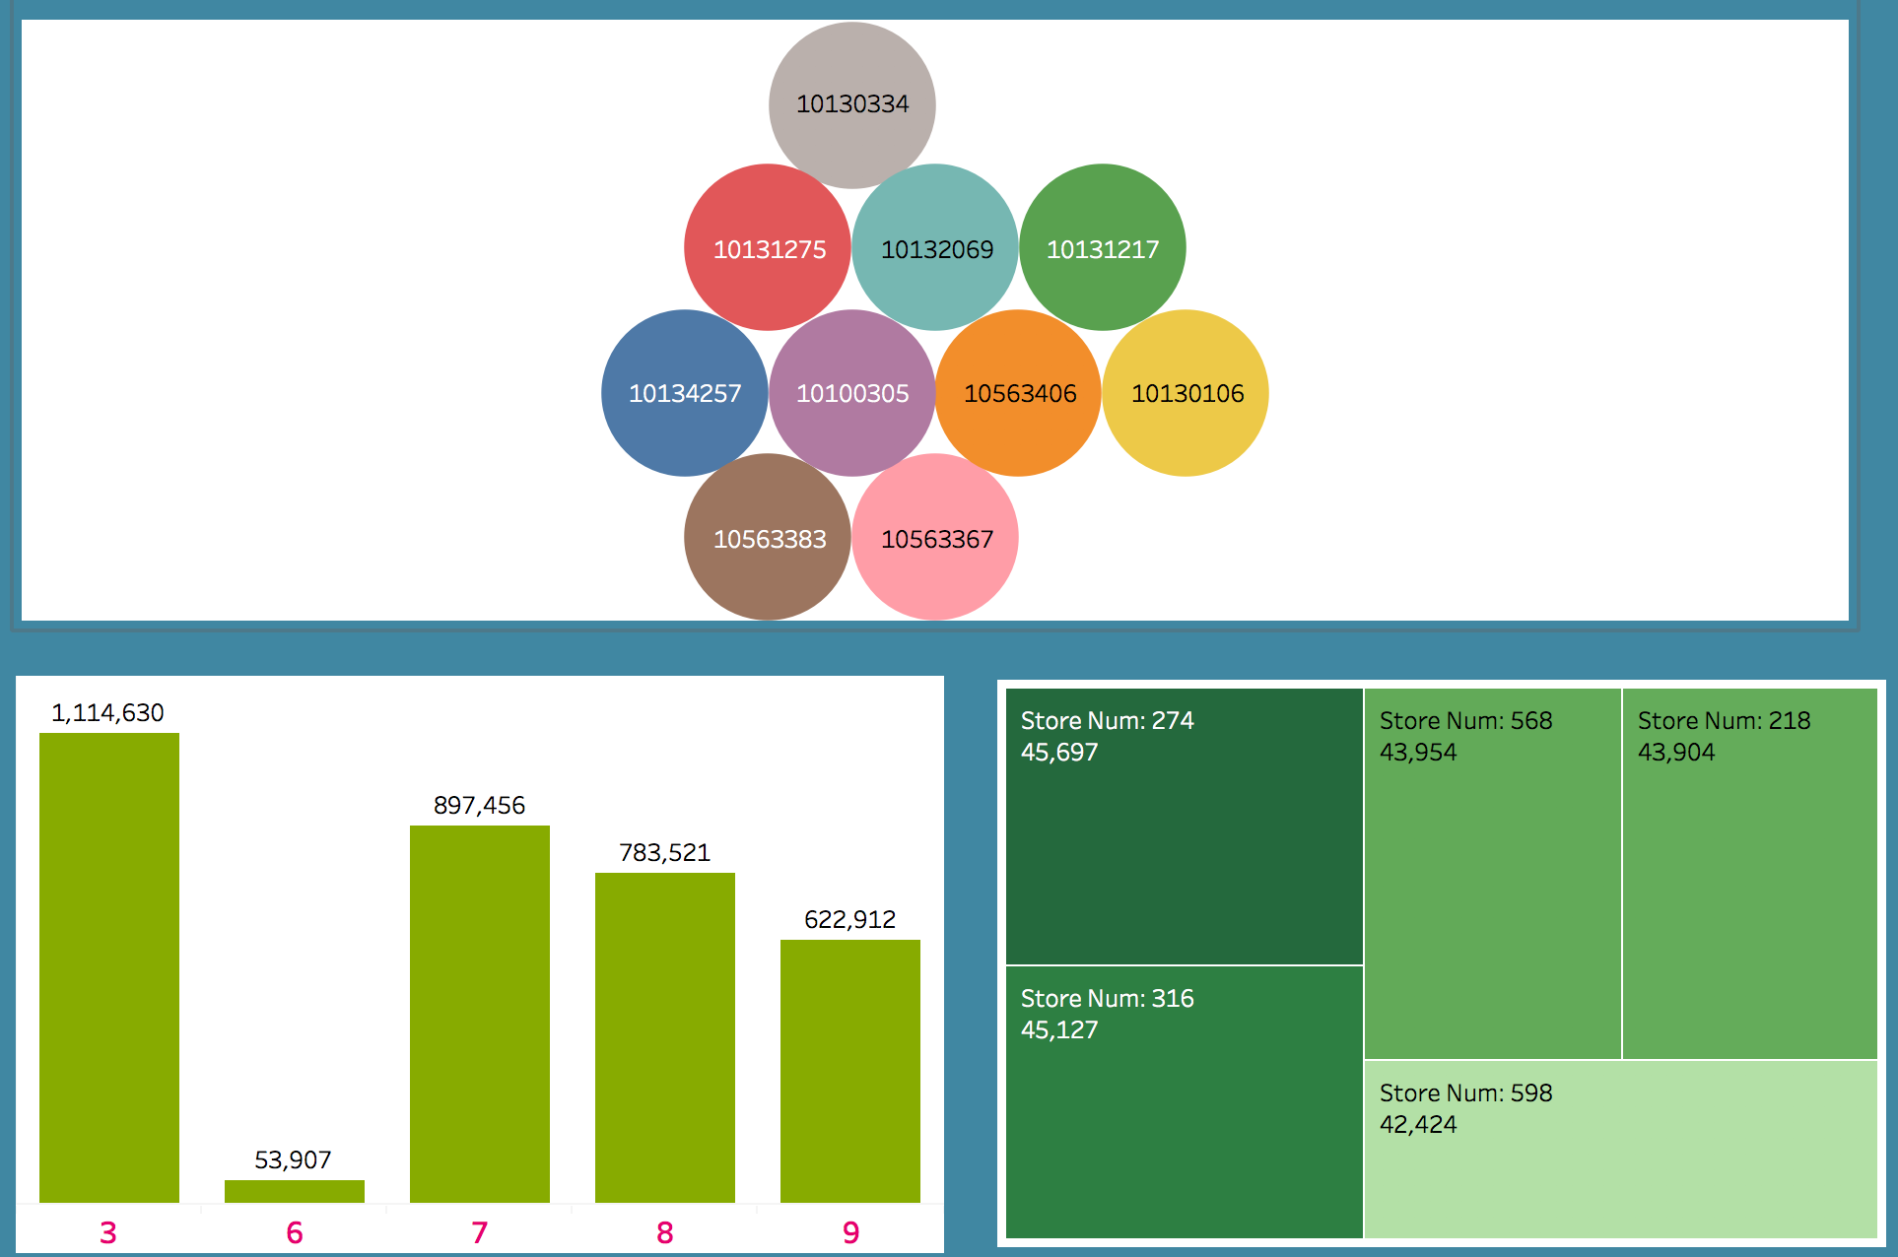
Freq. Plot - Top 10 items – Lift in sales

Slide 12
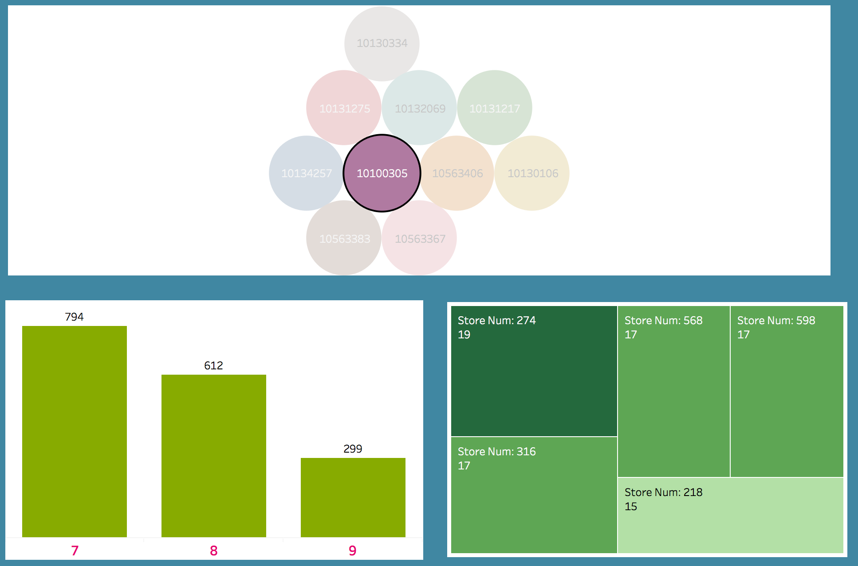
Lift in Sales – Item# 10100305

Slide 13
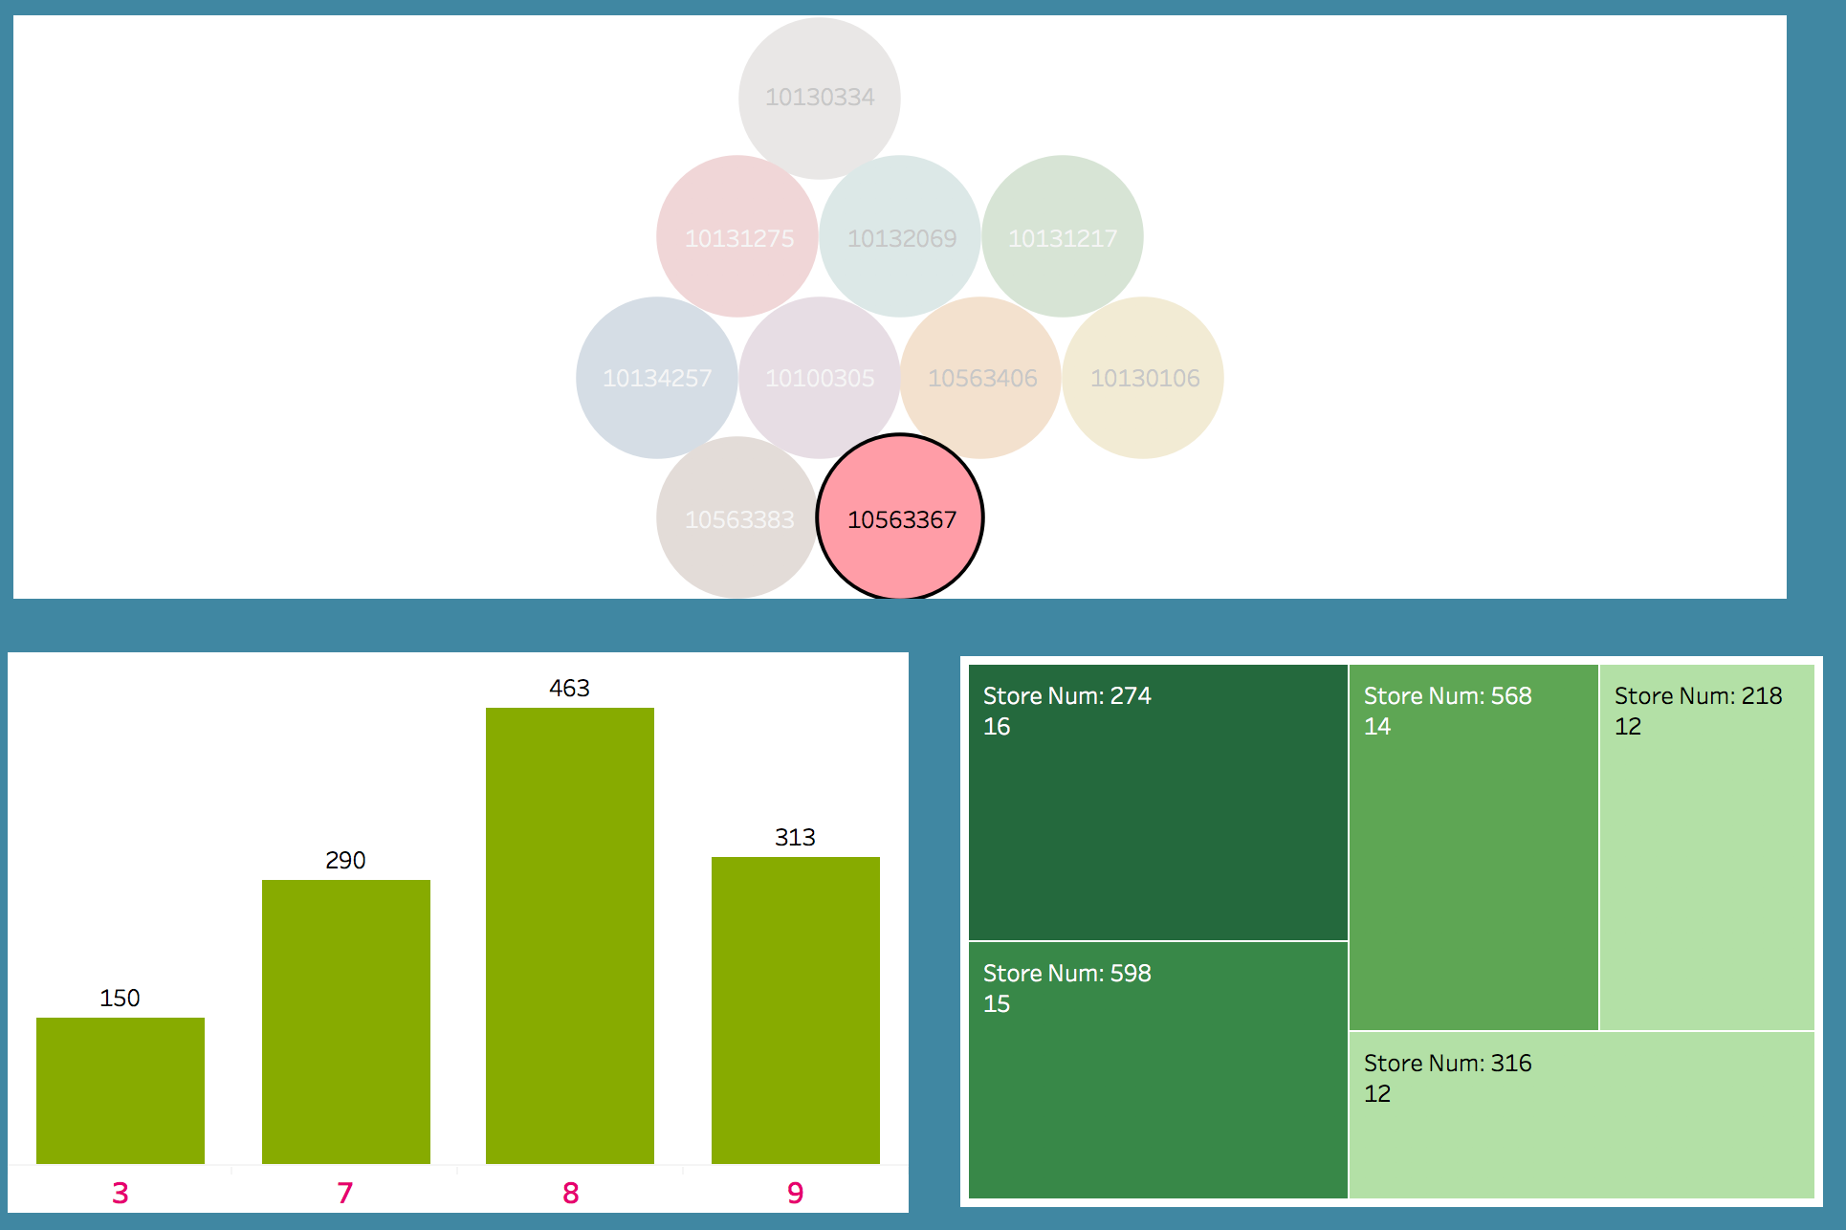
Lift in sales – Item #10563367

Slide 14
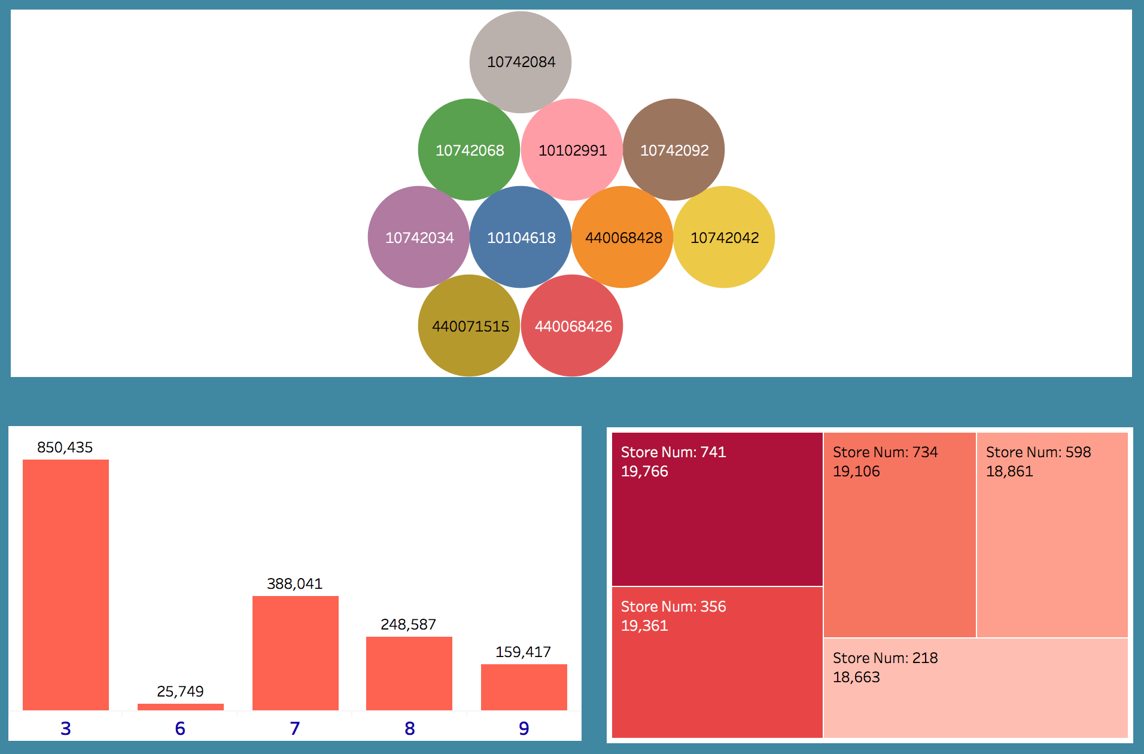
Freq. Plot - Top 10 items – Drop in sales

Slide 15
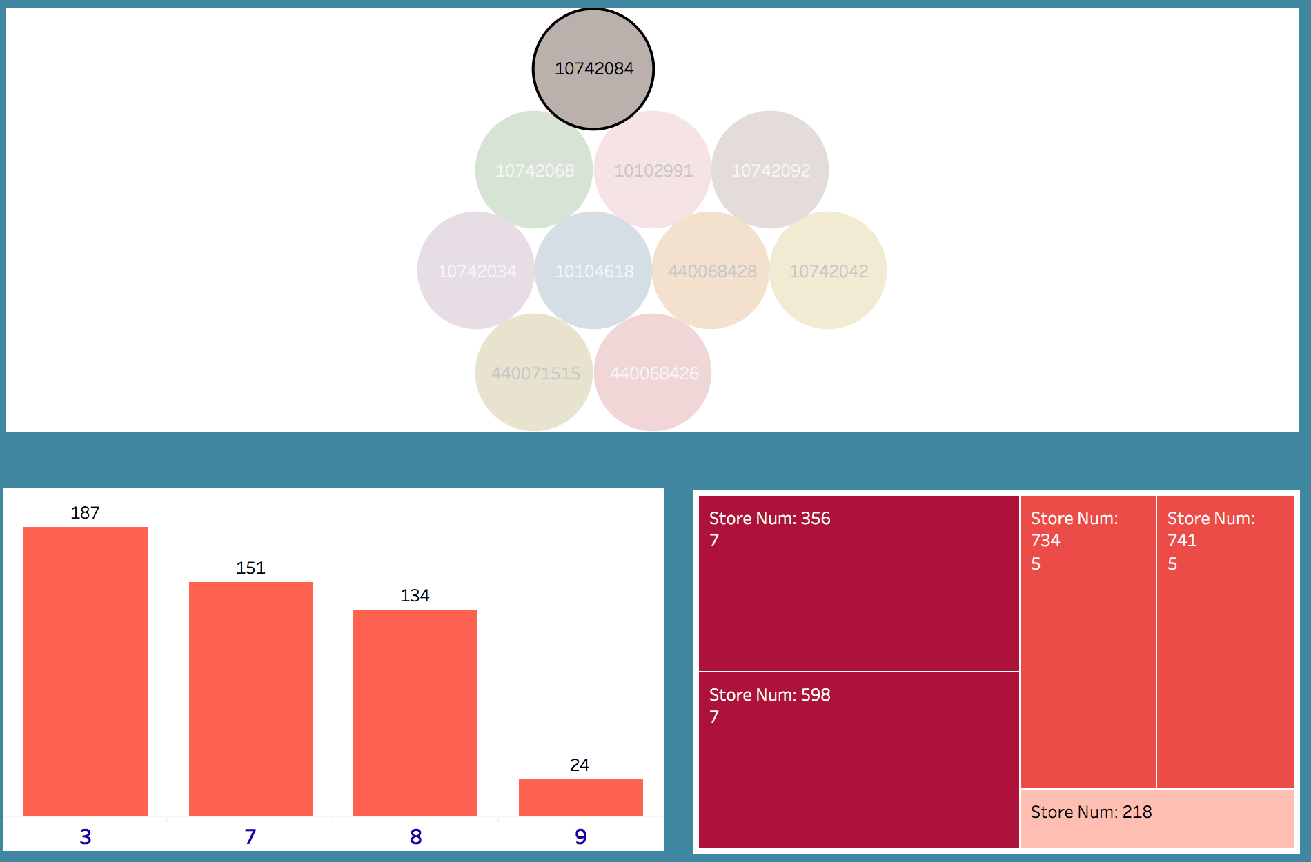
Drop in Sales – Item# 10742084

Slide 16
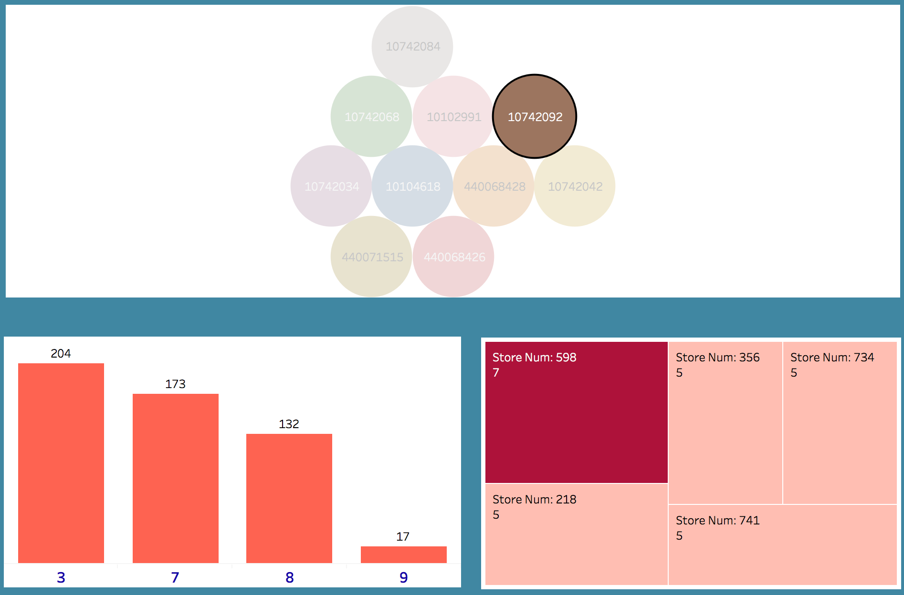
Drop in sales – Item #10742092

Slide 17
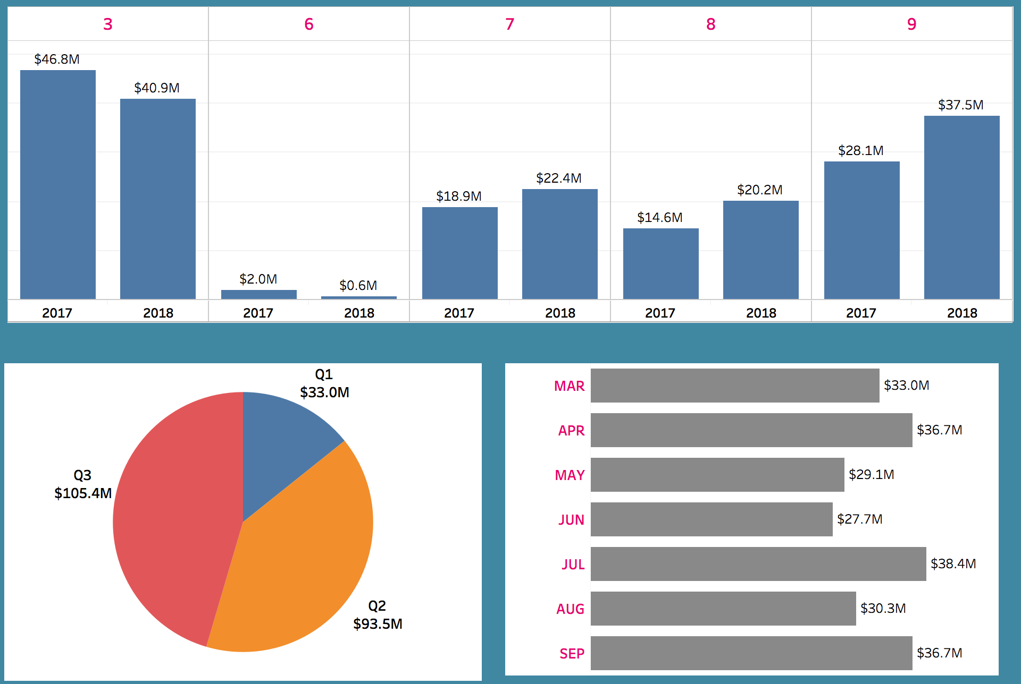
Ad performance by Gross Profit

Slide 18
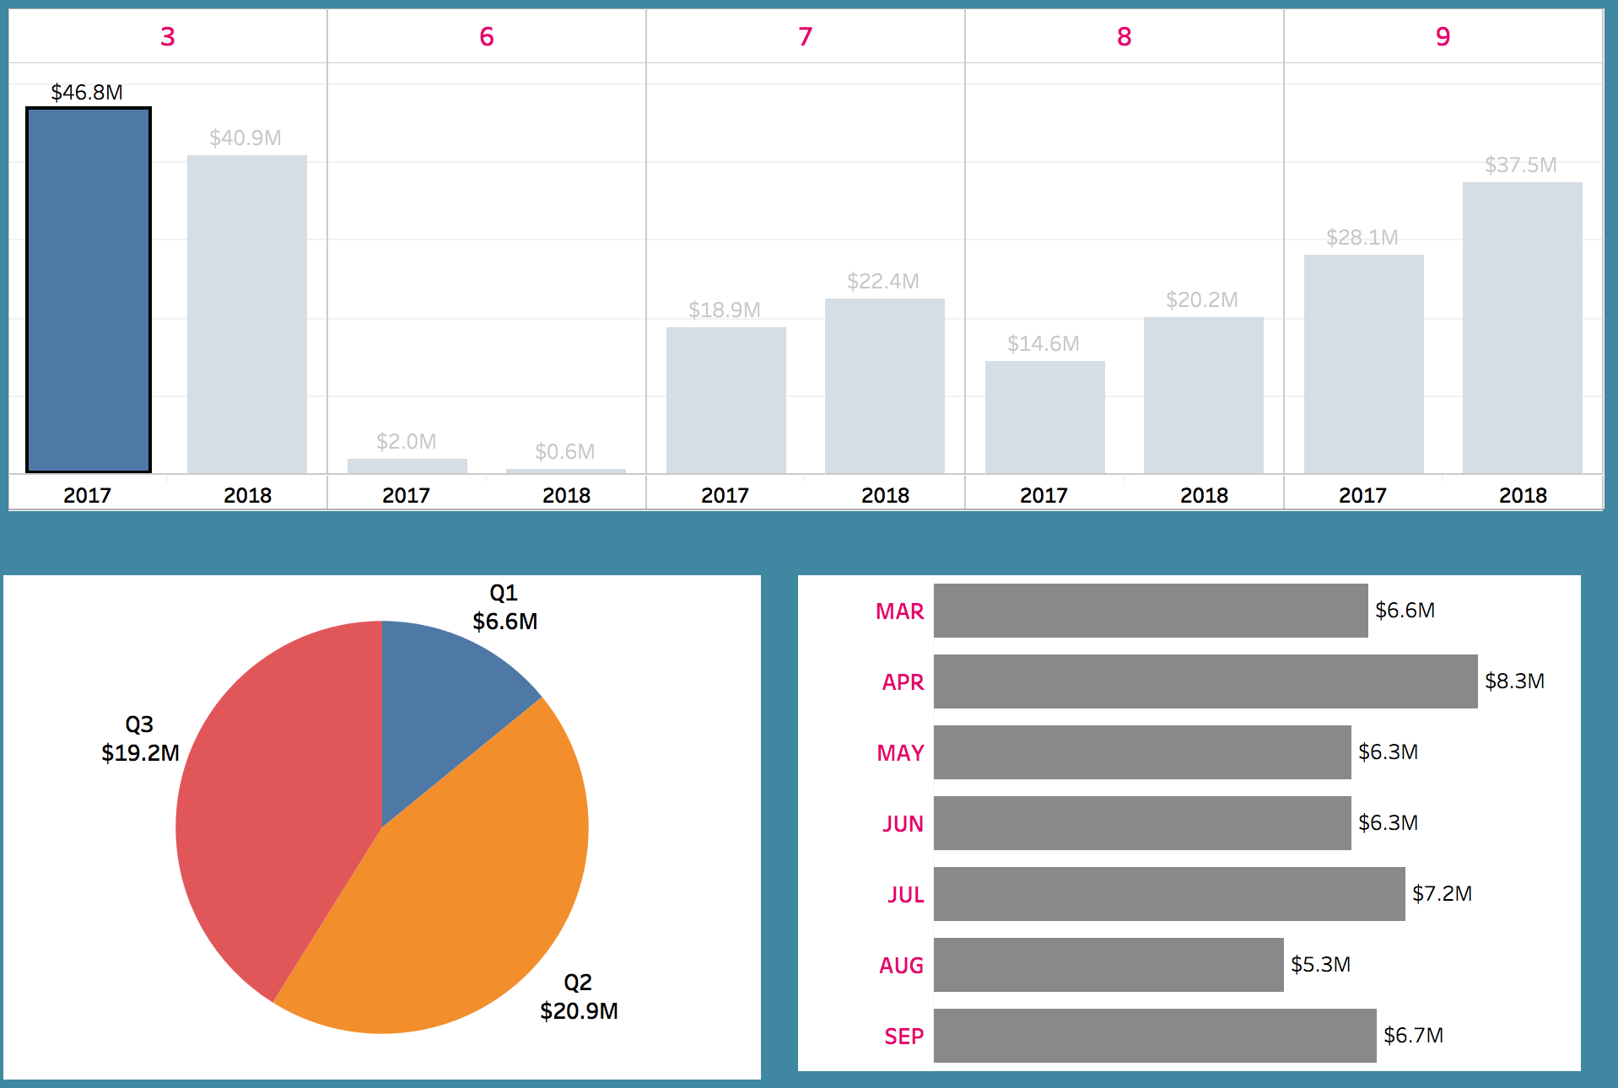
Ad perf. by Gross Profit – Ad Size 3 (2017)

Slide 19
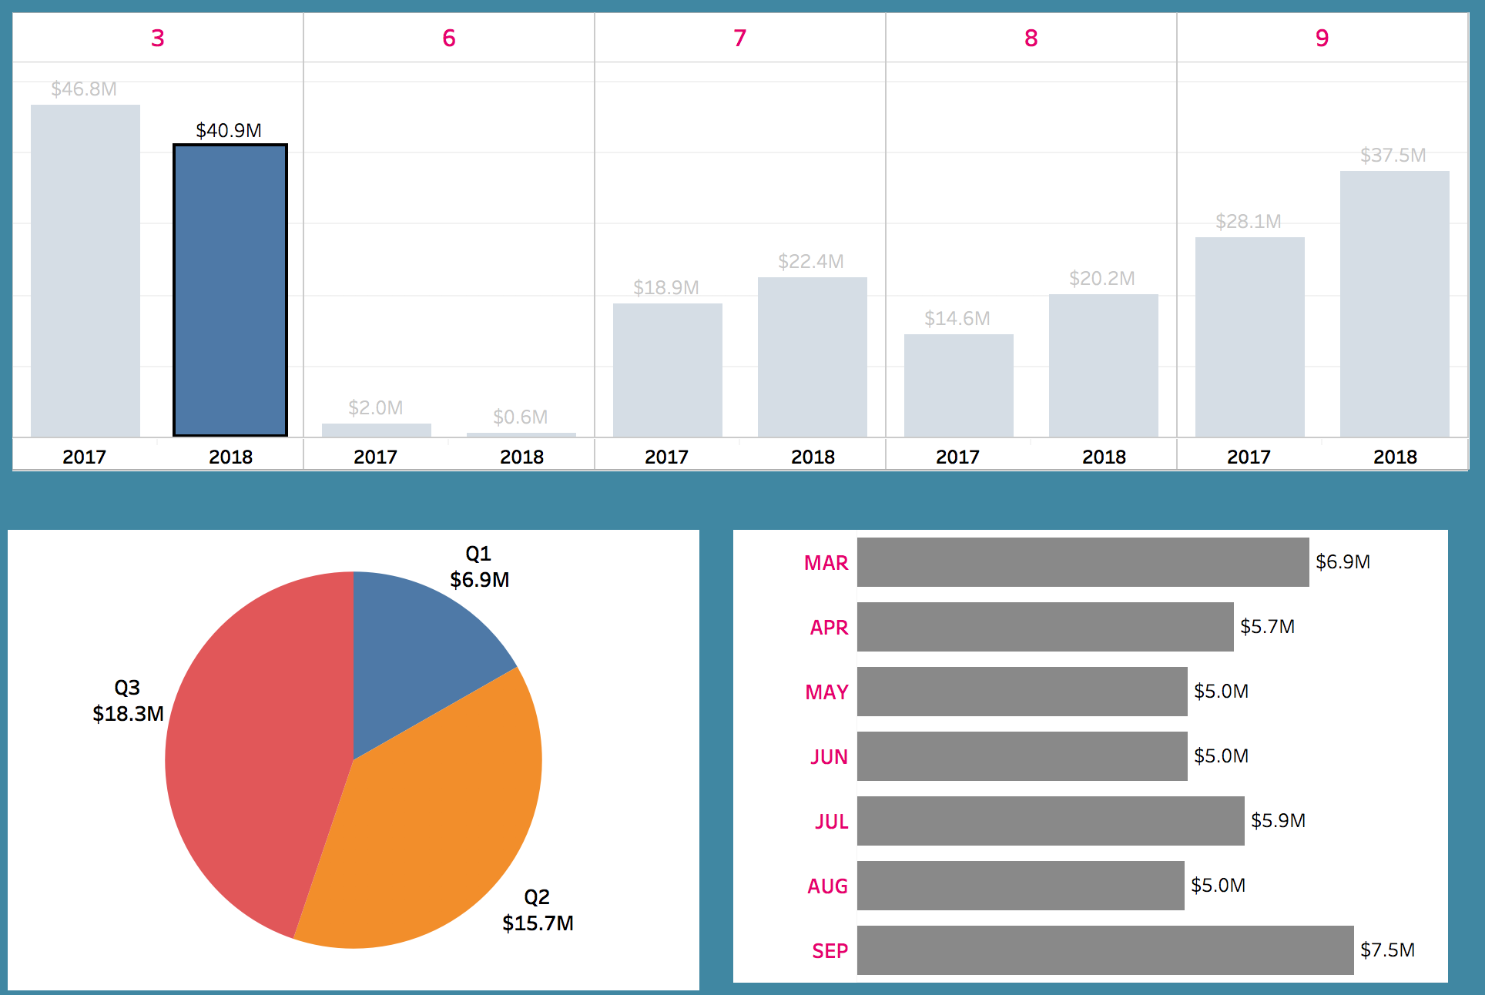
Ad perf. by Gross Profit – Ad Size 3 (2018)

Slide 20
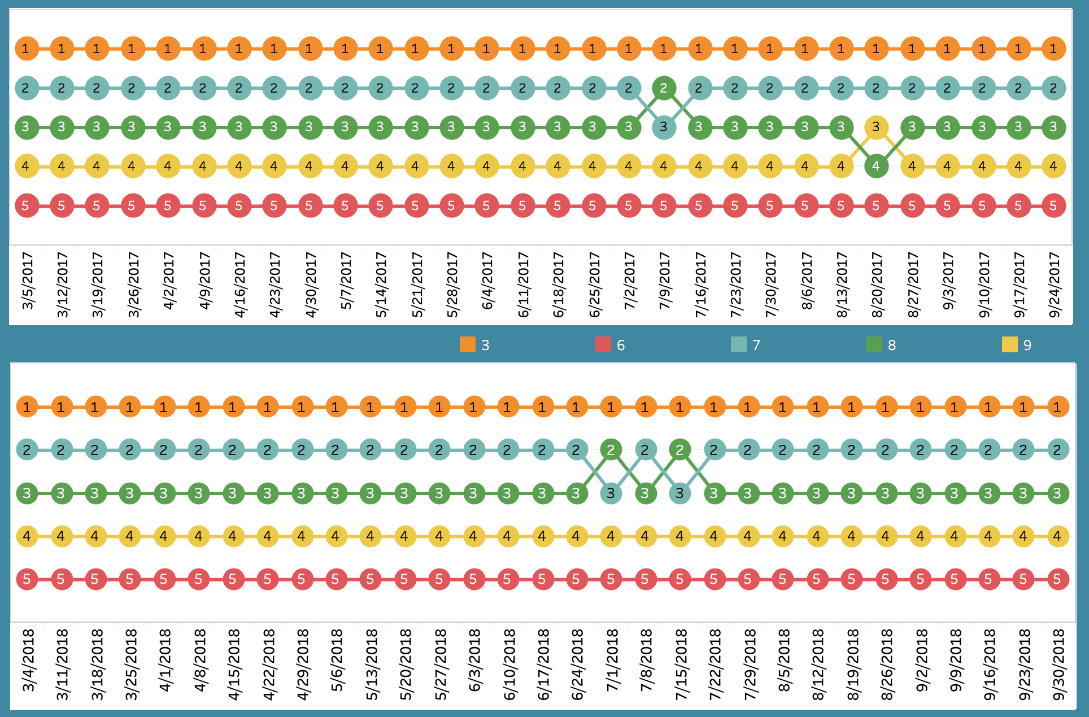
Ad size ranking by Gross Margin

Slide 21
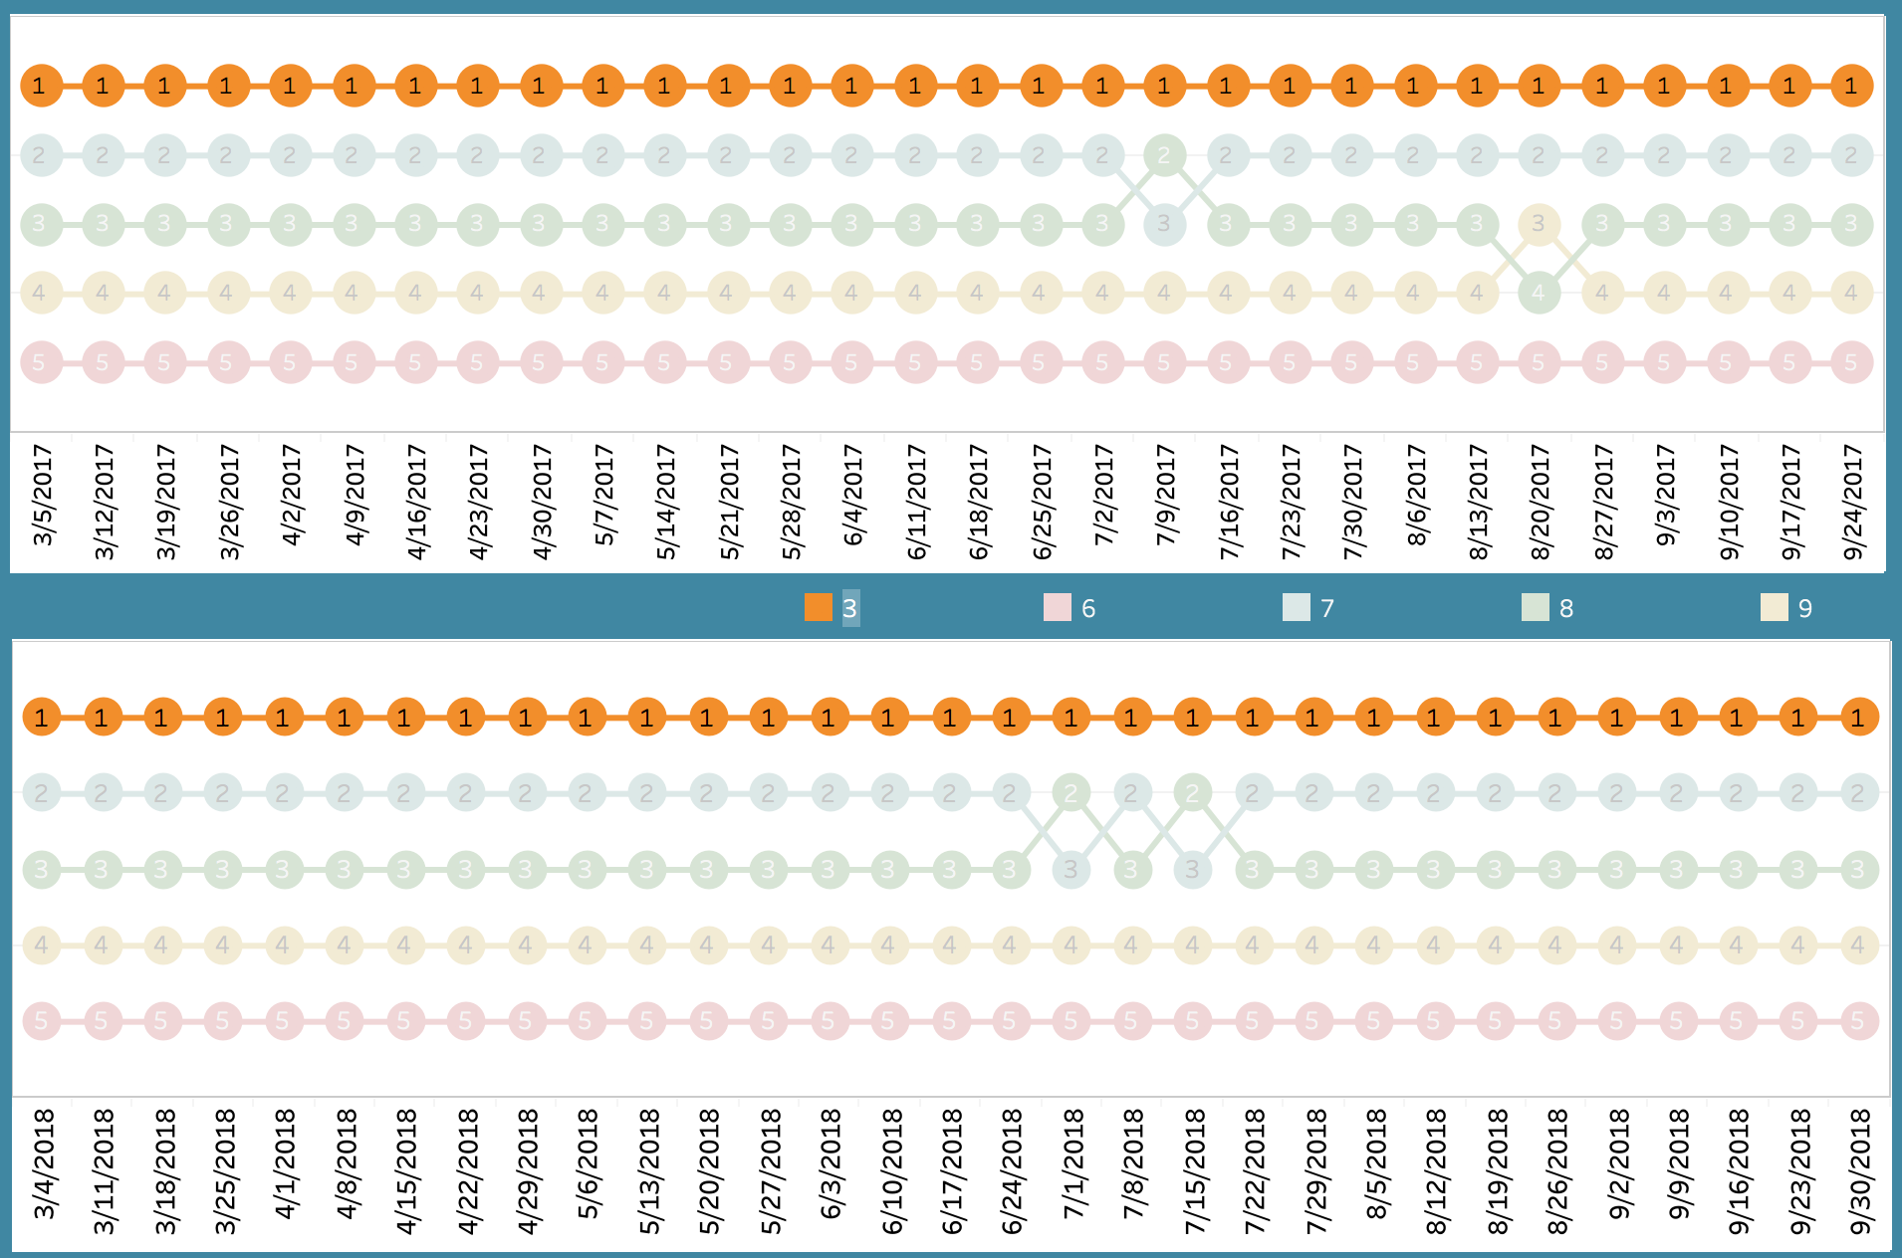
Ad ranking by Gross Margin – Ad size 3

Slide 22
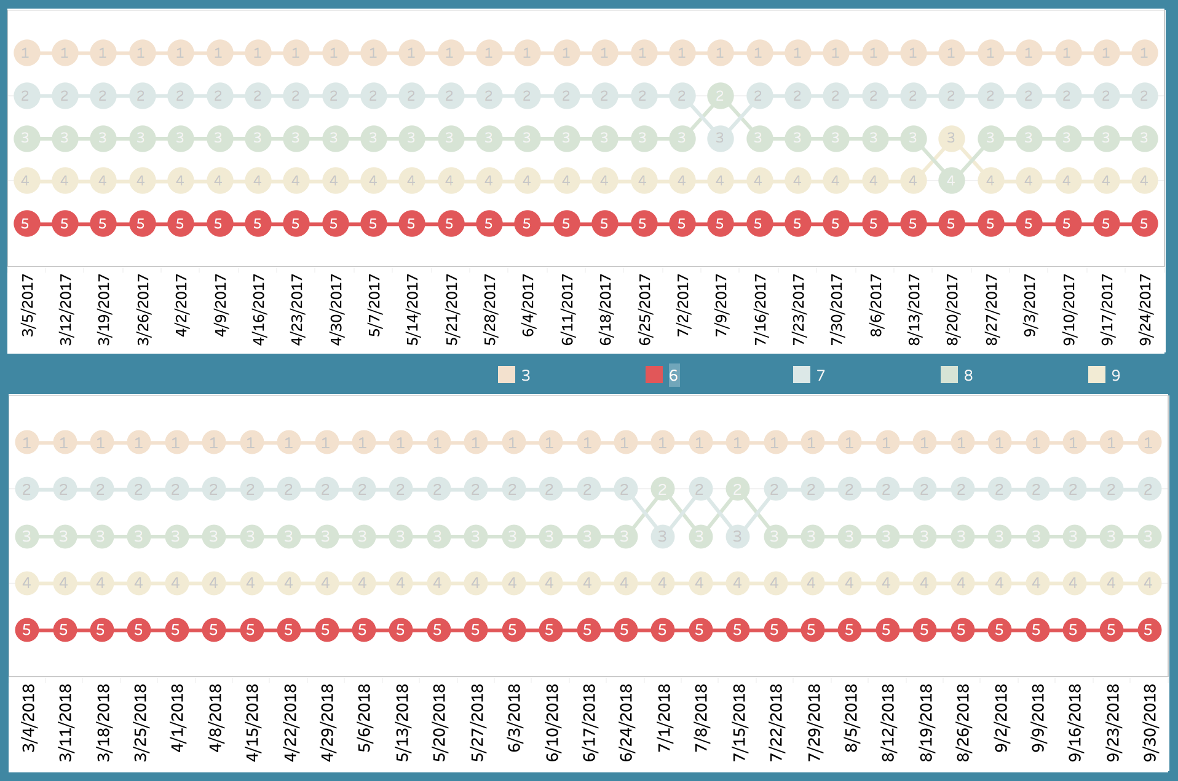
Ad ranking by Gross Margin – Ad size 6

Slide 23
Conclusion
LIFT
Ad size ranking cannot be generalized as LIFT analysis is done for each item in each store
Gross Profit
Both in 2017 and 2018, ad size ‘3’ was top performer and ad size ‘6’ was worst performer
Gross Margin
Both in 2017 and 2018, across each week, ad size ‘3’ was top performer and ad size ‘6’ was worst performer

Slide 24

.

